Slide 1
APACHE ATLAS
©2015 ITC Infotech. All Rights Reserved.

Slide 2
Existing Challenges
With in the huge Hadoop data lake, its highly difficult to track the data from where it is coming and to where it is flowing.
Although, business people know that some data is confidential, he should depend on IT admin to restrict acc to limited users.
There is no tool where user can go and search tables and see its schema and other information related to it.
©2015 ITC Infotech. All Rights Reserved.

Slide 3
How ATLAS can solve ?
Data Lineage
Tagging for access authorization
Ranger Integration
Text-Based & DSL search features
Centralized auditing
©2015 ITC Infotech. All Rights Reserved.

Slide 4
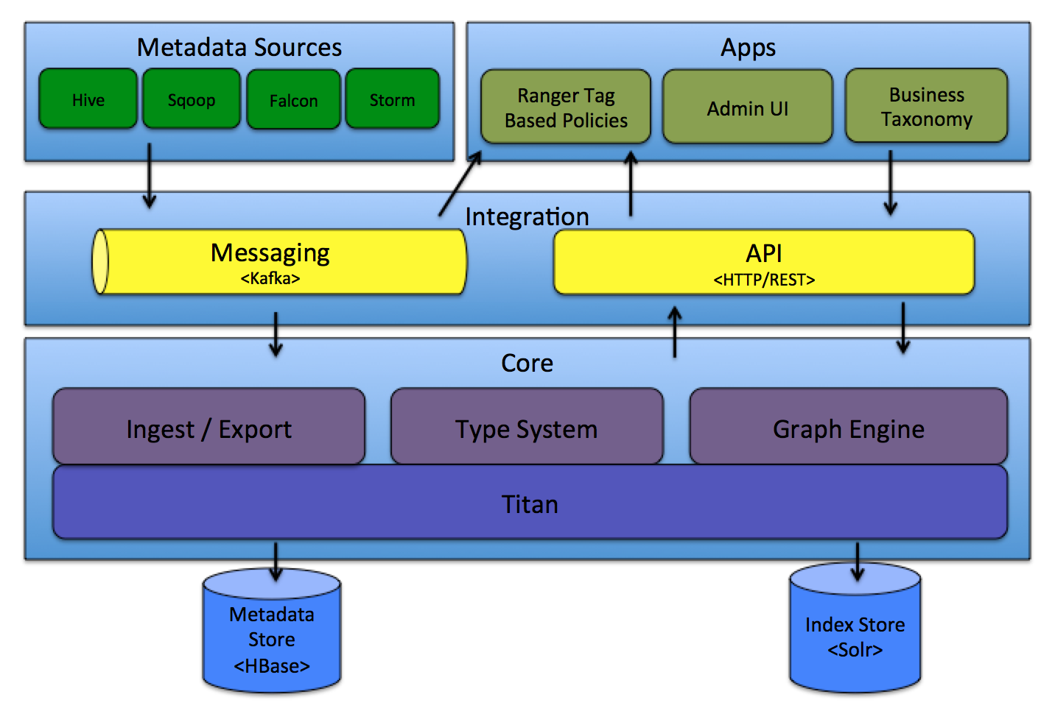
Architecture
©2015 ITC Infotech. All Rights Reserved.

Slide 5
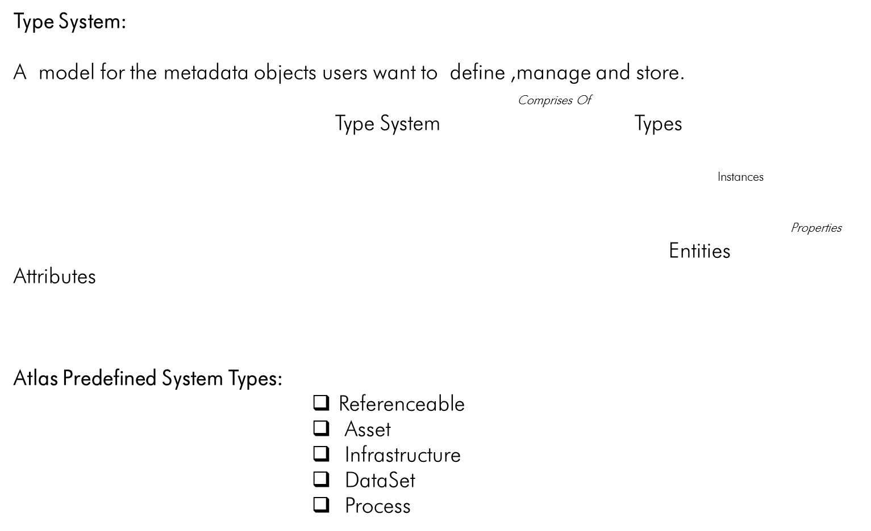
Type System
©2015 ITC Infotech. All Rights Reserved.

Slide 6
Type System
Types:
Define the properties for the metadata object.
Represents one or a collection of attributes.
Uniquely identified by a name.
Properties of Types:
MetaType:
Basic metatypes: E.g. Int, String, Boolean etc.
Enum metatypes
Collection metatypes: E.g. Array, Map
Composite metatypes:E.g. Class, Struct, Trait
SuperTypes:
A type can ‘extend’ from a parent type called ‘supertype. E.g:DataSet
Attributes:
Referencing the attributes using expression such as type_name.attribute_name. E.g: hive_table.name
We can define arbitrary relationships between two types defined in Atlas and thus build rich models.
©2015 ITC Infotech. All Rights Reserved.

Slide 7
Type System
Entities:
A specific value or instance of a Class ‘type’.
Represents a specific metadata object in the real world.
Every entity is identified by a unique identifier, a GUID.
Properties of Entities:
Id:
GUID of Entity. E.g. “9ba387dd-fa76-429c-b791-ffc338d3c91f”
typeName:
The name of the type the entity belongs to. E.g: hive_table
Values:
Map of all the attribute names and their values for attributes that are defined in the hive_table type definition.
E.g:
name: “customers”
db: "b42c6cfc-c1e7-42fd-a9e6-890e0adf33bc"
owner: “admin”
createTime: "2016-06-20T06:13:28.000Z"
lastAccessTime: "2016-06-20T06:13:28.000Z"
©2015 ITC Infotech. All Rights Reserved.

Slide 8
Type System
Attributes:
Definition of each attribute of an entity.
Properties of Attributes:
Name: Name of the attribute. E.g:db
dataTypeName: Metatype of the attribute. E.g: string,map,Class
isComposite: Independent of the entity it is contained in.
E.g: set of columns that make a part of a hive table. Since the columns do not have meaning outside of the hive table.
isIndexable: Attribute can be indexed on, so that look ups can be performed using the attribute value.
isUnique: Treated like a primary key to distinguish this entity from other entities
Multiplicity: Used to define constraint on the attribute. Attribute is required, optional, or could be multi-valued.
©2015 ITC Infotech. All Rights Reserved.

Slide 9
Bridge & Hook
Bridge:
Imports all metadata from any component’s(Hive/Sqoop/Falcon/Storm) metastore into Atlas using defined datamodel.
The metadata of all the pre-existing tables and definitions will be imported initially in one time as batch.
Available Bridges:
Hive Bridge, Sqoop Bridge, Falcon Bridge, Storm Bridge
Hook:
Any updates to metadata in the respective systems such as Hive,Sqoop,falcon& storm are captured and propagated to atlas server.
Atlas server consumes these notification events and updates its metastore.
Available Hook’s:
Hive Hook, Sqoop Hook, Falcon Hook, Storm Hook
©2015 ITC Infotech. All Rights Reserved.

Slide 10
Messaging & Notification
Messaging/Notification Server:
Atlas uses Apache Kafka as a notification server for communication between hooks and downstream consumers of metadata notification events.
Metadata Sources:
Ingest and manage metadata objects from the sources to the Atlas server.
Currently it supports the sources: Hive,Sqoop,Falcon,Storm
Ingest/Export: Ingest → allows metadata to be added to atlas
Export → Exposes metadata changes that are detected as events.
Graph Engine:
Responsible for translating between types and entities of the Type System, and the underlying Graph model and vice versa.
creates the appropriate indices for the metadata objects so that they can be searched for efficiently.
©2015 ITC Infotech. All Rights Reserved.

Slide 11
Core Components
Titan:
Titan is used as a library within Atlas to store the metadata objects.
Titan uses two stores: Metadata Store & Index Store
Index Store:
Allows Full-text and DSL search on stored metadata.
Uses Apache Solr by default to store the indices of metadata.
Metadata Store:
Uses Hbase as metadata store as default to store the proper metadata objects.
Titan persists the graph to
©2015 ITC Infotech. All Rights Reserved.

Slide 12
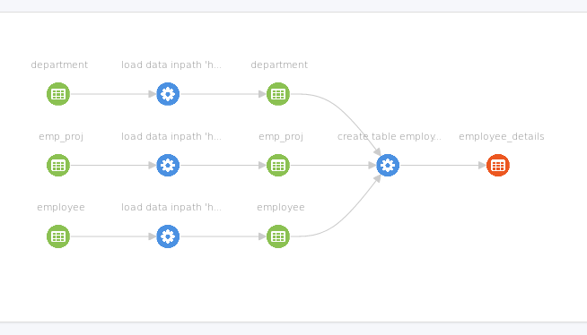
Data Lineage
1 - Created 3 tables in MYSQL(department, emp_proj, employee)
2 - Used Sqoop to import all the three tables into Hive.
3 - Created new table in hive(employee_details) using join condition on the imported 3 tables from MYSQL.
©2015 ITC Infotech. All Rights Reserved.

Slide 13
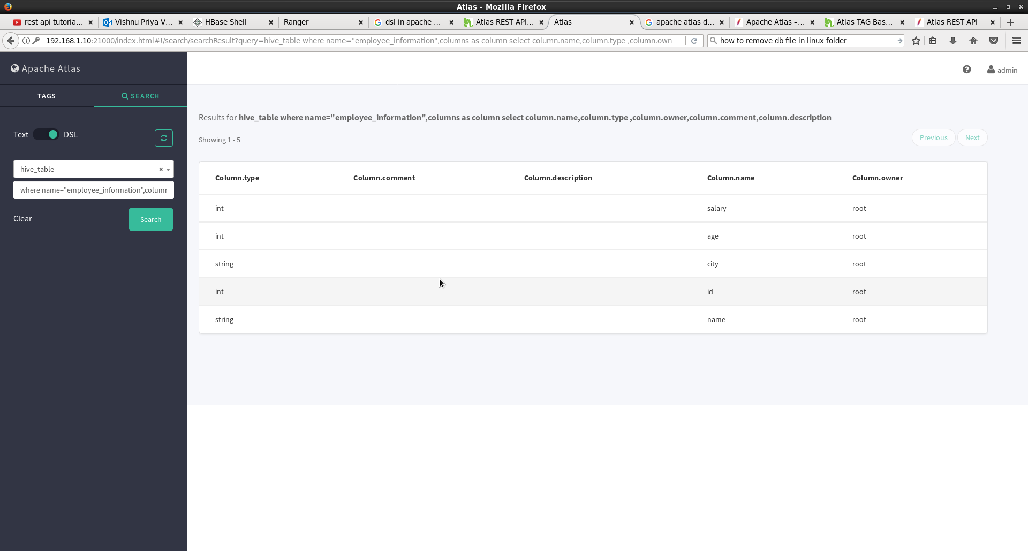
DSL Search using Atlas UI
©2015 ITC Infotech. All Rights Reserved.

Slide 14
DSL Search using REST API
DSL Search based on Table name "data" from the database "sample":
QUERY:
http://192.168.1.10:21000/api/atlas/discovery/search/dsl?query=hive_table+where+name%3D%27sample.data@bidw%27
Output:
{"requestId":"qtp1324989951-8153 - 178a554a-140c-4361-9fca-340abb857507","query":"hive_table where name='sample.data@bidw'","queryType":"dsl","count":0,"results":[],"dataType":{"superTypes":["DataSet"],"hierarchicalMetaTypeName":"org.apache.atlas.typesystem.types.ClassType","typeName":"hive_table","typeDescription":null,"attributeDefinitions":[{"name":"db","dataTypeName":"hive_db","multiplicity":{"lower":1,"upper":1,"isUnique":false},"isComposite":false,"isUnique":false,"isIndexable":false,"reverseAttributeName":null},{"name":"createTime","dataTypeName":"date","multiplicity":{"lower":0,"upper":1,"isUnique":false},"isComposite":false,"isUnique":false,"isIndexable":false,"reverseAttributeName":null},{"name":"lastAccessTime","dataTypeName":"date","multiplicity":{"lower":0,"upper":1,"isUnique":false},"isComposite":false,"isUnique":false,"isIndexable":false,"reverseAttributeName":null},{"name":"comment","dataTypeName":"string","multiplicity":{"lower":0,"upper":1,"isUnique":false},"isComposite":false,"isUnique":false,"isIndexable":false,"reverseAttributeName":null},{"name":"retention","dataTypeName":"int","multiplicity":{"lower":0,"upper":1,"isUnique":false},"isComposite":false,"isUnique":false,"isIndexable":false,"reverseAttributeName":null},{"name":"sd","dataTypeName":"hive_storagedesc","multiplicity":{"lower":0,"upper":1,"isUnique":false},"isComposite":true,"isUnique":false,"isIndexable":false,"reverseAttributeName":null},{"name":"partitionKeys","dataTypeName":"array<hive_column>","multiplicity":{"lower":0,"upper":1,"isUnique":false},"isComposite":true,"isUnique":false,"isIndexable":false,"reverseAttributeName":null},{"name":"aliases","dataTypeName":"array<string>","multiplicity":{"lower":0,"upper":1,"isUnique":false},"isComposite":true,"isUnique":false,"isIndexable":false,"reverseAttributeName":null},{"name":"columns","dataTypeName":"array<hive_column>","multiplicity":{"lower":0,"upper":1,"isUnique":false},"isComposite":true,"isUnique":false,"isIndexable":false,"reverseAttributeName":null},{"name":"parameters","dataTypeName":"map<string,string>","multiplicity":{"lower":0,"upper":1,"isUnique":false},"isComposite":false,"isUnique":false,"isIndexable":false,"reverseAttributeName":null},{"name":"viewOriginalText","dataTypeName":"string","multiplicity":{"lower":0,"upper":1,"isUnique":false},"isComposite":false,"isUnique":false,"isIndexable":false,"reverseAttributeName":null},{"name":"viewExpandedText","dataTypeName":"string","multiplicity":{"lower":0,"upper":1,"isUnique":false},"isComposite":false,"isUnique":false,"isIndexable":false,"reverseAttributeName":null},{"name":"tableType","dataTypeName":"string","multiplicity":{"lower":0,"upper":1,"isUnique":false},"isComposite":false,"isUnique":false,"isIndexable":false,"reverseAttributeName":null},{"name":"temporary","dataTypeName":"boolean","multiplicity":{"lower":0,"upper":1,"isUnique":false},"isComposite":false,"isUnique":false,"isIndexable":true,"reverseAttributeName":null}]}}
©2015 ITC Infotech. All Rights Reserved.

Slide 15
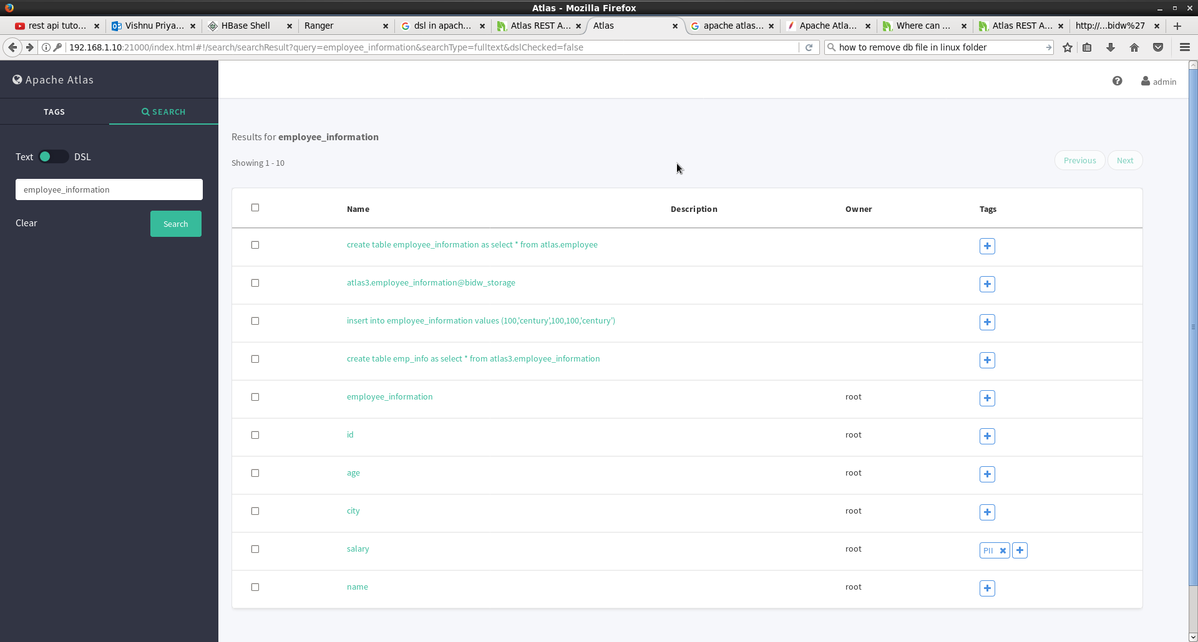
Full Text_based Search using Atlas UI
©2015 ITC Infotech. All Rights Reserved.

Slide 16
Full Text_based Search using REST API
Full text based search on Table name “employee_information" from the database “atlas3":
QUERY:
http://192.168.1.10:21000/api/atlas/discovery/search/fulltext?query=%27atlas3.employee_information@bidw%27
Output:
{"requestId":"qtp1324989951-44121 - 8f7d829c-6439-4c95-af35-9cd739d7620f","query":"'atlas3.employee_information@bidw'","queryType":"full-text","count":100,"results":[{"guid":"daab166d-60ce-41be-a794-332add063cc0","typeName":"hive_process","score":2.0814755},{"guid":"8523e432-5a62-4971-a6de-379e6a489129","typeName":"hive_table","score":1.9884764},{"guid":"f5ead875-408c-46b6-bbe4-f70d43123d08","typeName":"hive_storagedesc","score":1.9559343},{"guid":"f07e0209-d393-4783-975e-9a3eab00bffd","typeName":"hive_process","score":1.8521998},{"guid":"94c972c6-f0c0-4566-b332-627e5d4919e3","typeName":"hive_column","score":1.7087404},{"guid":"1adf12f2-9d9b-46ef-a4d2-2ae41bb15507","typeName":"hive_column","score":1.7087404},{"guid":"2cd747d1-3f28-4ebe-8590-1fd39af57483","typeName":"hive_column","score":1.7087404},{"guid":"474b1fc5-57bd-434f-9e25-8a3a34d5cd88","typeName":"hive_column","score":1.7087404},{"guid":"a023ff7b-301b-43bc-8661-5ffb5b4165c3","typeName":"hive_column","score":1.7087404},{"guid":"00141937-4533-410a-86cb-baf215c3aab1","typeName":"hive_db","score":0.99163926},{"guid":"fa75da0d-a512-43a8-a74a-3f061194cad4","typeName":"hive_process","score":0.76999366},{"guid":"3a39f567-db0b-4a76-af2a-2dcac646ae38","typeName":"hive_table","score":0.63843554},{"guid":"251c0b2f-04d8-4a86-a0d7-91396fbcb8dc","typeName":"hive_column","score":0.5459285},{"guid":"83acd0b3-cec9-4f30-b377-5a62c69add08","typeName":"hive_column","score":0.5459285},{"guid":"dcef72cb-379b-46c5-9a09-af56ff0a2aa4","typeName":"hive_column","score":0.5459285},{"guid":"cef8b873-e418-46f8-af60-c019da7c6ff1","typeName":"hive_column","score":0.5459285},{"guid":"caa1c53f-0638-4a5f-b8cb-15c9e59b4d52","typeName":"hive_column","score":0.5459285},{"guid":"1c96beb6-ccd2-47ae-8860-5bd92f73dd94","typeName":"hive_storagedesc","score":0.46910045},{"guid":"ab3b51e8-1b54-494e-a194-c1bdd45796d3","typeName":"hive_db","score":0.02931774},{"guid":"758b50de-c48c-4c3b-b954-84e2cbbabafc","typeName":"hive_db","score":0.02931774},{"guid":"ac0d34a9-d6f6-45ba-9d32-1c9c2c1688a1","typeName":"hive_db","score":0.02931774},{"guid":"166fda47-a415-4bf8-8628-6ed0f997c62e","typeName":"hive_db","score":0.02931774},{"guid":"faf87c84-57ee-4bc3-a8b9-198ba5d0e998","typeName":"hive_db","score":0.02931774},{"guid":"308809d6-37d8-49ec-82e9-5b8763fc329c","typeName":"hive_db","score":0.02931774},{"guid":"0eff24ff-1976-4bce-bccf-d5bb3623b220","typeName":"hive_db","score":0.02931774},{"guid":"57a19193-46c0-4893-ac14-a98fb60875fc","typeName":"hive_db","score":0.02931774},{"guid":"d85b7c9b-84b7-47a7-a5d5-b0dcd6d7b6f9","typeName":"hive_db","score":0.02931774},{"guid":"ace9b889-cf8c-493f-86ac-053d201f20f0","typeName":"hive_db","score":0.025129493},{"guid":"bf1a1f2f-6a16-4cba-87ea-914716fff929","typeName":"hive_db","score":0.025129493},{"guid":"a6ac09f7-df0f-4907-a6e6-3fea473b512a","typeName":"hive_db","score":0.025129493},{"guid":"9d73f8e1-f08b-466a-a260-0fab637a435e","typeName":"hive_db","score":0.025129493},{"guid":"0aed626a-2b33-410a-8b48-678872d24451","typeName":"hive_db","score":0.025129493},{"guid":"4c09d169-52a1-4be5-9bd8-108aeb599ab7","typeName":"hive_db","score":0.025129493},{"guid":"e1c80a9e-cabf-4e7b-ab34-d8dc9f046581","typeName":"hive_process","score":0.020518145},{"guid":"f1cfd94c-dd13-4489-aa27-0868e09a6b9e","typeName":"hive_process","score":0.020518145},{"guid":"25d78f94-6ace-4b6e-974b-994ada7ccf61","typeName":"hive_process","score":0.020518145},{"guid":"5efff5ee-0392-484d-a5fd-24e9bc7164c4","typeName":"hive_process","score":0.020518145},{"guid":"483e7e2d-75ff-4ed2-acae-05abc18c882b","typeName":"hive_process","score":0.020518145},{"guid":"e4041e90-6ffd-4026-b12b-e5ea534e4a9d","typeName":"hive_process","score":0.020518145},{"guid":"870fa9a8-1778-4f8f-97f1-919428cf5c2a","typeName":"hive_process","score":0.020518145},{"guid":"c9027f74-8c2a-48fd-8cb5-c36e9723b753","typeName":"hive_process","score":0.017953377},{"guid":"1279dac2-fdd6-4cb1-8f77-54dc5f5563de","typeName":"hive_process","score":0.017953377},{"guid":"0f85cb3e-2c28-4271-bb8d-1f4e6f0dfbe1","typeName":"hive_process","score":0.017953377},{"guid":"5031ed74-e5fd-4209-87c6-45aeb9622564","typeName":"hive_process","score":0.017953377},{"guid":"ad8a94b5-759a-4904-b957-564b84635648","typeName":"hive_process","score":0.017953377},{"guid":"445036d5-1fc2-4d96-a047-45da36e779a4","typeName":"hive_process","score":0.017953377},{"guid":"8edd418e-31bd-4910-830c-5ef6bab86702","typeName":"hive_process","score":0.017953377},{"guid":"adfa512e-86f3-4dee-8458-4d85f45dc72a","typeName":"hive_process","score":0.017953377},{"guid":"6d47cfe4-3663-4c59-a38d-1c201b8d027c","typeName":"hive_process","score":0.017953377},{"guid":"299844da-a313-441b-b9cc-cb14ce09bfc2","typeName":"hive_process","score":0.017953377},{"guid":"d0518c82-911e-4bf1-b374-a741b7899722","typeName":"hive_process","score":0.017953377},{"guid":"3209057b-9b66-499b-ae85-9788d451d0a0","typeName":"hive_process","score":0.017953377},{"guid":"745fbd8d-bd96-4204-9615-237787684f56","typeName":"hive_process","score":0.017953377},{"guid":"1add52fa-6a65-412c-a058-d04d8bf4eb13","typeName":"hive_process","score":0.017953377},{"guid":"07e9baa2-8c95-4cb1-9e00-22290f9a05fd","typeName":"hive_process","score":0.017953377},{"guid":"4e3517c4-0e5a-424d-88d9-4360625234af","typeName":"hive_process","score":0.017953377},{"guid":"c608828b-f16f-41ad-8a9e-4c16ae951fb5","typeName":"hive_process","score":0.017953377},{"guid":"5ef9facb-6efe-4bc0-bace-e00fe1396fea","typeName":"hive_process","score":0.017953377},{"guid":"fee5e74d-1586-480d-9583-254d251f9fa3","typeName":"hive_process","score":0.017953377},{"guid":"a09035ba-4768-4a00-aa63-49118de73d3f","typeName":"hive_process","score":0.017953377},{"guid":"1ef8678a-98f3-47b7-98c9-e730f7140100","typeName":"hive_process","score":0.017953377},{"guid":"7cb93bee-09f0-49db-bc0c-d9a649b61bc0","typeName":"hive_process","score":0.017953377},{"guid":"bdcafe16-d52f-4ff3-b64a-cea1eec4fdb4","typeName":"hive_process","score":0.017953377},{"guid":"b4796274-247a-4d31-bdf9-0d3b25740fe1","typeName":"hive_process","score":0.017953377},{"guid":"ca73205b-2158-439a-bee3-fb4771a38e51","typeName":"hive_process","score":0.017953377},{"guid":"c9938825-327e-438d-88cc-0648443ae440","typeName":"hive_process","score":0.017953377},{"guid":"02f7abe9-a6b9-4ade-87ef-544a6414701b","typeName":"hive_process","score":0.017953377},{"guid":"248af23b-faa9-49be-b8a0-90ce4901ef63","typeName":"hive_process","score":0.017953377},{"guid":"97433912-01da-48ba-96ac-1f7256a7c033","typeName":"hive_process","score":0.017953377},{"guid":"5d5ada95-5c3f-432e-9cec-11f46bf59842","typeName":"hive_process","score":0.017953377},{"guid":"5d362932-ffe4-4773-af3a-b9563578b3a9","typeName":"hive_process","score":0.017953377},{"guid":"537bfdd5-abc9-4397-bd9f-aa074d8fb7cc","typeName":"hive_process","score":0.017953377},{"guid":"9683d94d-4f9e-4468-8019-f9835b79527d","typeName":"hive_process","score":0.017953377},{"guid":"409b2759-2e2c-443d-add6-97cac450523c","typeName":"hive_process","score":0.017953377},{"guid":"fd6c93cf-2107-4aa1-a84a-a75805b1b23f","typeName":"hive_process","score":0.017953377},{"guid":"776637ca-a603-46ff-8fb3-ae0bee314809","typeName":"hive_process","score":0.017953377},{"guid":"1b0efd3c-5262-488b-8665-25a76d67f3d9","typeName":"hive_process","score":0.017953377},{"guid":"c416959d-63f2-48d7-862f-2ff1e9c82e3f","typeName":"hive_process","score":0.017953377},{"guid":"2f9a0aab-646a-4ad9-8d70-a722813d19d1","typeName":"hive_process","score":0.017953377},{"guid":"c2269908-9574-4280-8007-65c76a0f9cce","typeName":"hive_process","score":0.017953377},{"guid":"28c9a60f-679d-47c4-8aa4-6d3c90118809","typeName":"hive_process","score":0.017953377},{"guid":"8e37af75-324a-40bd-8721-00037fe180ea","typeName":"hive_process","score":0.017953377},{"guid":"9c2e6875-c8af-4c39-9f5a-8e540e078a08","typeName":"hive_process","score":0.017953377},{"guid":"bc98708d-7134-4ae0-8a39-049ef725227e","typeName":"hive_process","score":0.017953377},{"guid":"85cc4893-c936-49e1-bda1-3e3381f14974","typeName":"hive_process","score":0.017953377},{"guid":"542e3665-12e8-4629-af94-a20a4a984633","typeName":"hive_process","score":0.017953377},{"guid":"a926da74-3391-417d-990f-912797f0cb9a","typeName":"hive_process","score":0.017953377},{"guid":"21bb9e51-fc8e-48eb-9ae4-10928b347edf","typeName":"hive_column","score":0.016752996},{"guid":"f90c522d-e3fa-4ca7-8388-09eaee54b65b","typeName":"hive_column","score":0.016752996},{"guid":"39f72ab0-4958-48b2-9973-9acdffee7143","typeName":"hive_column","score":0.016752996},{"guid":"953474ee-ade2-40a0-a0fb-360d145e1b58","typeName":"hive_column","score":0.016752996},{"guid":"4135e2ff-7935-41b1-a3ab-8dd7c1623e28","typeName":"hive_column","score":0.016752996},{"guid":"c97e573d-cdd9-4e80-a388-4de3d5353659","typeName":"hive_column","score":0.016752996},{"guid":"602285f1-dcdd-417c-89b3-9fc064b1f8c6","typeName":"hive_column","score":0.016752996},{"guid":"17745804-242f-448b-880e-230d11ba5d47","typeName":"hive_column","score":0.016752996},{"guid":"aa7f09c1-6078-4471-a0c8-5cbca3311de4","typeName":"hive_column","score":0.016752996},{"guid":"23131cc7-aa20-492b-bdc9-74df2a559a69","typeName":"hive_column","score":0.016752996},{"guid":"6c591fd4-feaf-4a92-be07-238778fb29d6","typeName":"hive_column","score":0.016752996},{"guid":"85f2d384-c7e8-4fb8-a388-342af0868fad","typeName":"hive_column","score":0.016752996},{"guid":"cda35565-f46d-44c6-a5cd-9f1cd0150d11","typeName":"hive_column","score":0.016752996}]}
©2015 ITC Infotech. All Rights Reserved.

Slide 17
Atlas REST API
We can create,acess and update the metadatastore objects stored in Atlas by using REST API.
List all types in ATLAS:
Query:
http://localhost:21000/api/atlas/types
Output:
{"results":["Asset","Process","hive_column","storm_node","storm_bolt","falcon_process","hive_serde","falcon_feed_replication","hbase_table","kafka_topic","hive_table","hive_storagedesc","sqoop_dbdatastore","fs_permissions","hive_principal_type","jms_topic","hive_process","falcon_cluster","storm_spout","Referenceable","falcon_feed_creation","falcon_feed","hdfs_path","sqoop_process","Infrastructure","storm_topology","hive_order","DataSet","fs_path","hive_db","file_action"],"count":31,"requestId":"qtp1052163107-19 - f2560c81-4af4-4741-a553-49f5978c0503"}
Retrieve an entity definition by GUID:
Query:
http://localhost:21000/api/atlas/entities/{2af695eb-5984-44df-83f3-874c128c4345}
Output:
{"requestId":"qtp1324989951-395 - 5e7b6bdd-7932-4af3-96e0-54b9589b37c1","definition":{"jsonClass":"org.apache.atlas.typesystem.json.InstanceSerialization$_Reference","id":{"jsonClass":"org.apache.atlas.typesystem.json.InstanceSerialization$_Id","id":"2af695eb-5984-44df-83f3-874c128c4345","version":0,"typeName":"hive_table","state":"DELETED"},"typeName":"hive_table","values":{"aliases":null,"tableType":"EXTERNAL_TABLE","name":"flight_lookup","viewExpandedText":null,"createTime":"2017-05-12T10:08:54.000Z","description":null,"temporary":false,"db":{"jsonClass":"org.apache.atlas.typesystem.json.InstanceSerialization$_Id","id":"308809d6-37d8-49ec-82e9-5b8763fc329c","version":0,"typeName":"hive_db","state":"ACTIVE"},"viewOriginalText":null,"retention":0,"qualifiedName":"sample.flight_lookup@bidw","columns":[{"jsonClass":"org.apache.atlas.typesystem.json.InstanceSerialization$_Reference","id":{"jsonClass":"org.apache.atlas.typesystem.json.InstanceSerialization$_Id","id":"b3c74102-e90f-4e77-875d-58cb6829b51f","version":0,"typeName":"hive_column","state":"DELETED","version":0,"typeName":"hive_column","state":"DELETED1,"inputFormat":"org.apache.hadoop.mapred.TextInputFormat","parameters":null,"storedAsSubDirectories":false,"table":{"jsonClass":"org.apache.atlas.typesystem.json.InstanceSerialization$_Id","id":"2af695eb-5984-44df-83f3-874c128c4345","version":0,"typeName":"hive_table","state":"DELETED"}},"traitNames":[],"traits":{}},"parameters":{"rawDataSize":"645","numFiles":"1","transient_lastDdlTime":"1494584286","totalSize":"860","comment":"Data about flight details from a public database","EXTERNAL":"TRUE","COLUMN_STATS_ACCURATE":"{\"BASIC_STATS\":\"true\"}","numRows":"215"},"partitionKeys":null},"traitNames":[],"traits":{}}}
©2015 ITC Infotech. All Rights Reserved.

Slide 18
Atlas REST API
Retrieve lineage of dataset:
Query:
http://192.168.1.10:21000/api/atlas/lineage/hive/table/{vishnu.emp@bidw}/inputs/graph
Output:
{"requestId":"qtp1324989951-1202 - 2e6501b9-8b6d-438e-b55f-90a08e1df261","tableName":"vishnu.emp@bidw","results":{"jsonClass":"org.apache.atlas.typesystem.json.InstanceSerialization$_Struct","typeName":"__tempQueryResultStruct155","values":{"vertices":{"ed544822-a4f9-4edc-8c81-4f7fdd9e1e78":{"jsonClass":"org.apache.atlas.typesystem.json.InstanceSerialization$_Struct","typeName":"__tempQueryResultStruct154","values":{"qualifiedName":"default.employee@bidw","vertexId":{"jsonClass":"org.apache.atlas.typesystem.json.InstanceSerialization$_Struct","typeName":"__IdType","values":{"guid":"ed544822-a4f9-4edc-8c81-4f7fdd9e1e78","state":"ACTIVE","typeName":"hive_table"}},"name":"employee"}},"83c150ff-fecb-4f4e-a1c7-b33a5405bc20":{"jsonClass":"org.apache.atlas.typesystem.json.InstanceSerialization$_Struct","typeName":"__tempQueryResultStruct154","values":{"qualifiedName":"default.values__tmp__table__1_temp-56d507bf-042f-4684-9b97-cb2002d7b52e@bidw","vertexId":{"jsonClass":"org.apache.atlas.typesystem.json.InstanceSerialization$_Struct","typeName":"__IdType","values":{"guid":"83c150ff-fecb-4f4e-a1c7-b33a5405bc20","state":"ACTIVE","typeName":"hive_table"}},"name":"values__tmp__table__1"}},"4fb529c3-73c3-446d-b952-80e250026900":{"jsonClass":"org.apache.atlas.typesystem.json.InstanceSerialization$_Struct","typeName":"__tempQueryResultStruct154","values":{"qualifiedName":"default.values__tmp__table__1_temp-84aab7f2-eed1-4099-9430-49d98994c557@bidw","vertexId":{"jsonClass":"org.apache.atlas.typesystem.json.InstanceSerialization$_Struct","typeName":"__IdType","values":{"guid":"4fb529c3-73c3-446d-b952-80e250026900","state":"ACTIVE","typeName":"hive_table"}},"name":"values__tmp__table__1"}},"556c7864-c3d3-401b-a3c8-be51ed9d1b8d":{"jsonClass":"org.apache.atlas.typesystem.json.InstanceSerialization$_Struct","typeName":"__tempQueryResultStruct154","values":{"qualifiedName":"default.values__tmp__table__1_temp-505dfe63-a1f0-4e94-b81b-f35d2a91071d@bidw","vertexId":{"jsonClass":"org.apache.atlas.typesystem.json.InstanceSerialization$_Struct","typeName":"__IdType","values":{"guid":"556c7864-c3d3-401b-a3c8-be51ed9d1b8d","state":"ACTIVE","typeName":"hive_table"}},"name":"values__tmp__table__1"}},"8c8e8fb0-7479-481c-93d7-f32b1699edd8":{"jsonClass":"org.apache.atlas.typesystem.json.InstanceSerialization$_Struct","typeName":"__tempQueryResultStruct154","values":{"qualifiedName":"vishnu.emp@bidw","vertexId":{"jsonClass":"org.apache.atlas.typesystem.json.InstanceSerialization$_Struct","typeName":"__IdType","values":{"guid":"8c8e8fb0-7479-481c-93d7-f32b1699edd8","state":"ACTIVE","typeName":"hive_table"}},"name":"emp"}},"c26b2786-8629-4c3e-8ebe-c2d07b1ffff7":{"jsonClass":"org.apache.atlas.typesystem.json.InstanceSerialization$_Struct","typeName":"__tempQueryResultStruct154","values":{"qualifiedName":"hdfs:\/\/server.hdp.com:8020\/user\/hduser\/employee","vertexId":{"jsonClass":"org.apache.atlas.typesystem.json.InstanceSerialization$_Struct","typeName":"__IdType","values":{"guid":"c26b2786-8629-4c3e-8ebe-c2d07b1ffff7","state":"ACTIVE","typeName":"hdfs_path"}},"name":"employee"}}},"edges":{"f1cfd94c-dd13-4489-aa27-0868e09a6b9e":["4fb529c3-73c3-446d-b952-80e250026900"],"23d9b5cf-10bf-49a6-88a2-9751cddae9c3":["c26b2786-8629-4c3e-8ebe-c2d07b1ffff7"],"5efff5ee-0392-484d-a5fd-24e9bc7164c4":["556c7864-c3d3-401b-a3c8-be51ed9d1b8d"],"ed544822-a4f9-4edc-8c81-4f7fdd9e1e78":["e1c80a9e-cabf-4e7b-ab34-d8dc9f046581","23d9b5cf-10bf-49a6-88a2-9751cddae9c3","f1cfd94c-dd13-4489-aa27-0868e09a6b9e","5efff5ee-0392-484d-a5fd-24e9bc7164c4"],"210ee75f-253c-4ab2-9946-b2f7d4853a60":["ed544822-a4f9-4edc-8c81-4f7fdd9e1e78"],"8c8e8fb0-7479-481c-93d7-f32b1699edd8":["210ee75f-253c-4ab2-9946-b2f7d4853a60"],"e1c80a9e-cabf-4e7b-ab34-d8dc9f046581":["83c150ff-fecb-4f4e-a1c7-b33a5405bc20"]}}}}
©2015 ITC Infotech. All Rights Reserved.

Slide 19
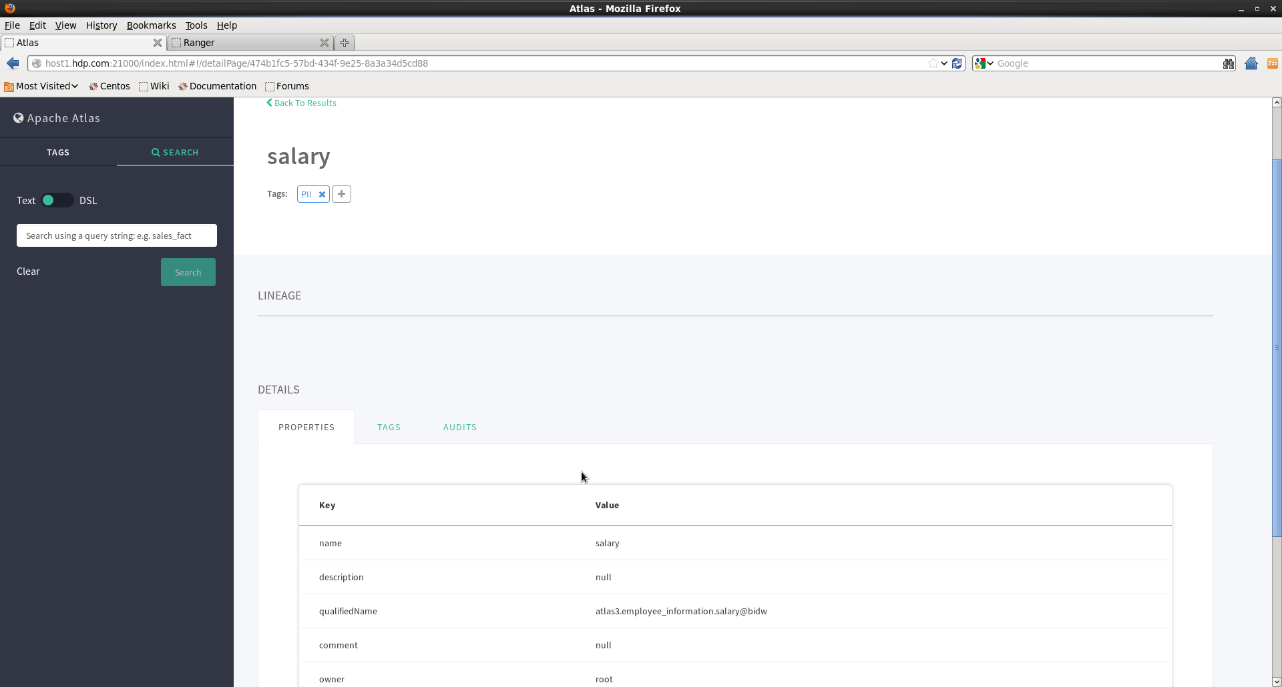
Tagging
©2015 ITC Infotech. All Rights Reserved.

Slide 20
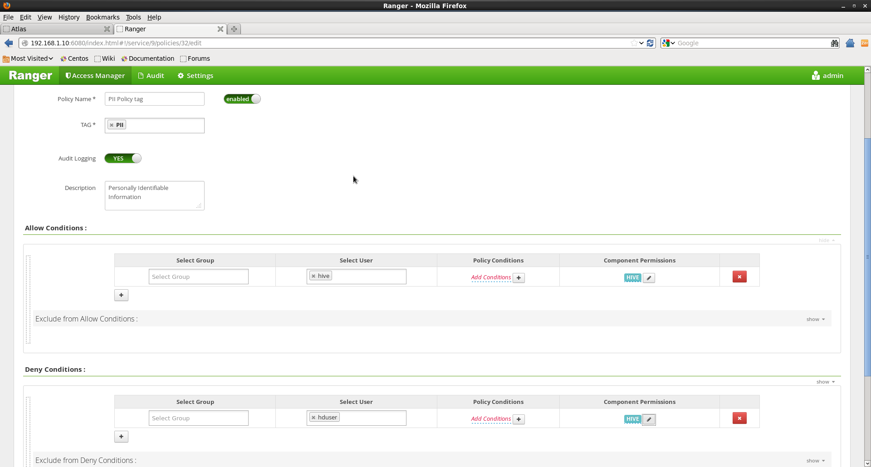
Created a policy for the tag PII in Ranger
©2015 ITC Infotech. All Rights Reserved.

Slide 21
APACHE RANGER
©2015 ITC Infotech. All Rights Reserved.

Slide 22
Functionality & Business use
Centralized Security Administration.
Resource based policies.
Tag based policies.
Audit logging
Masking
Row level filtering
©2015 ITC Infotech. All Rights Reserved.

Slide 23
Centralized Security Administration
Ranger can be integrated with HBase, Hive, HDFS, Storm, YARN, Kafka etc
Ranger metadata will be stored in RDBMS, mysql in this case.
©2015 ITC Infotech. All Rights Reserved.

Slide 24
Resource based policies
Create an access policy for the list of users.
This policy can be scalable and can be implemented on column level.
Access can be restricted in HDFS file systems, Hive DB’s, tables, columns etc.
©2015 ITC Infotech. All Rights Reserved.

Slide 25
Tag based policies
Ranger is integrated with Atlas.
Atlas has the feasibility to create a tag.
So an appropriate tag based policy can be created in Ranger.
During the policy creation, authorized and unauthorized users can be listed for that tag based policy.
©2015 ITC Infotech. All Rights Reserved.

Slide 26
Audit Logging, Masking
Audit entries will be created for the appropriate policies.
Data can be masked using Ranger policy.
Lets say there is an id which is confidential, id = ABC123. We can set an access policy for some users to not to show that ID. Like XXXNNN will be displayed.
©2015 ITC Infotech. All Rights Reserved.

Slide 27
Row Level Filtering
Ranger is capable of restricting data at row level.
Employee ID starting with AB alone will be visible to particular user ID’s and other data is restricted.
©2015 ITC Infotech. All Rights Reserved.

Slide 28
Limitations
Ranger will act as secondary admin. So, all the existing hdfs access for the users has to be revoked. Then create the policies using Ranger.
Currently, Ranger supports only Hive2. So, existing hive access for all the users has to be revoked. Request them to access hive using beeline which will connect to hive2.
©2015 ITC Infotech. All Rights Reserved.

Slide 29
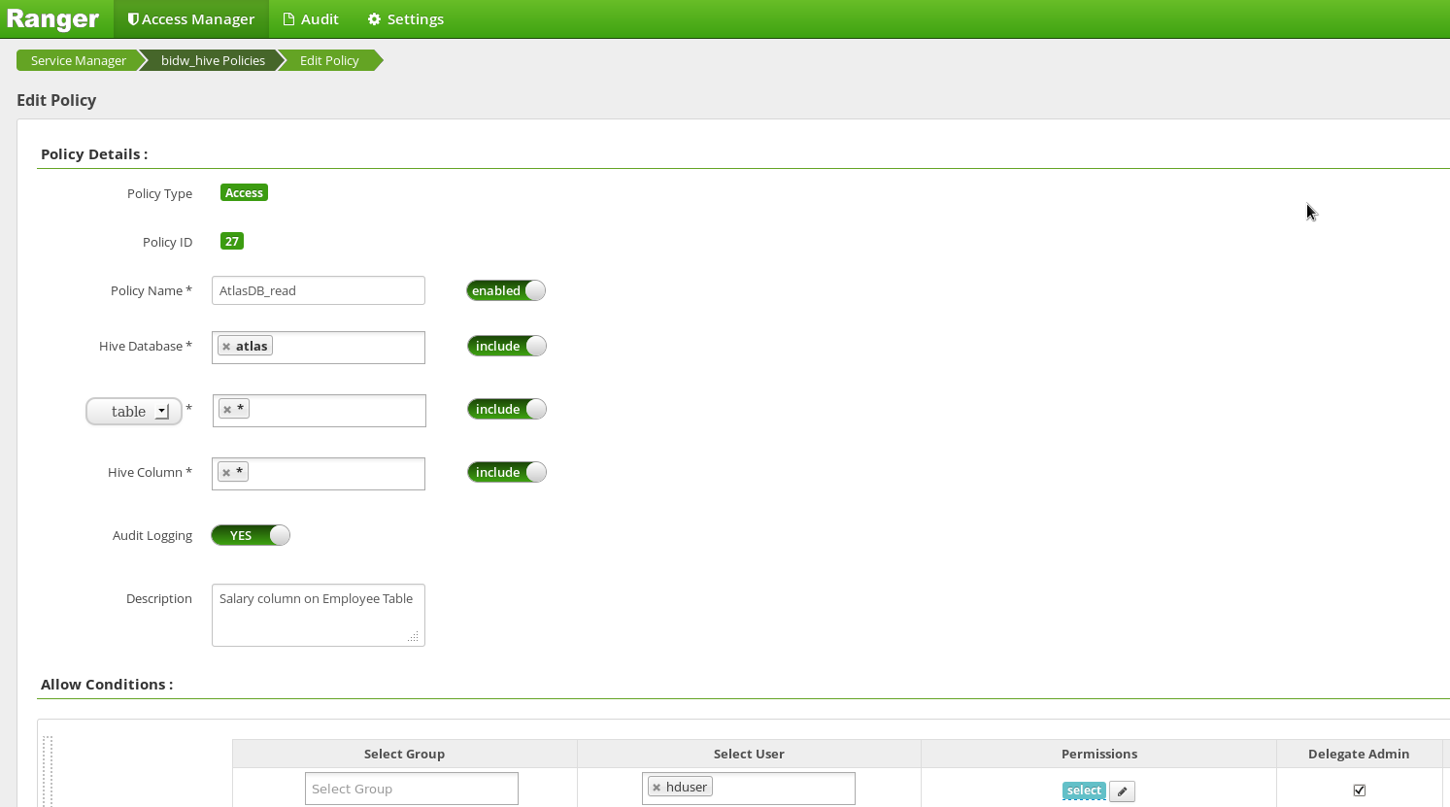
Policy for hduser to read atlasDB
©2015 ITC Infotech. All Rights Reserved.

Slide 30
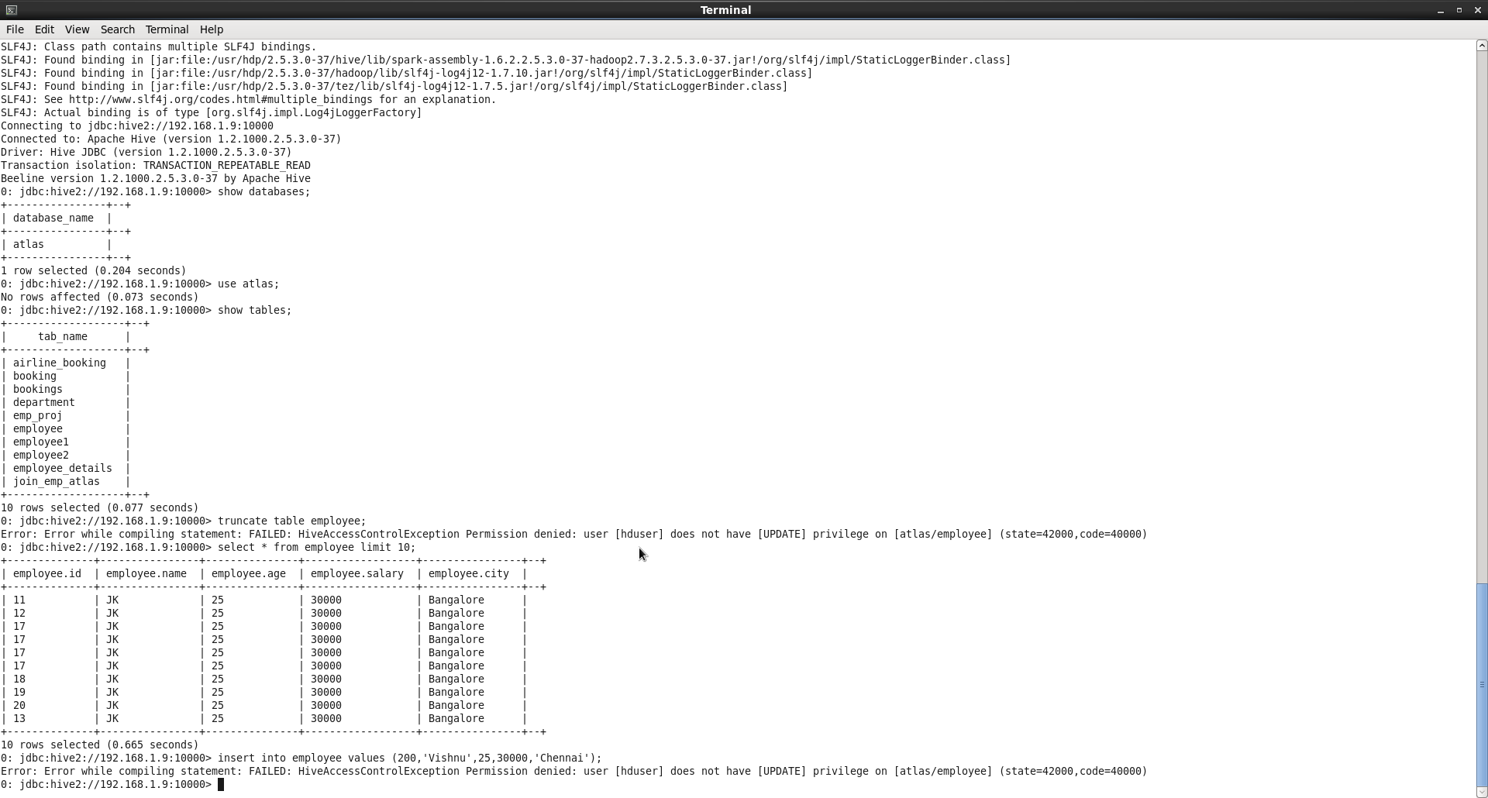
Access restricted for hduser for writes
©2015 ITC Infotech. All Rights Reserved.

Slide 31
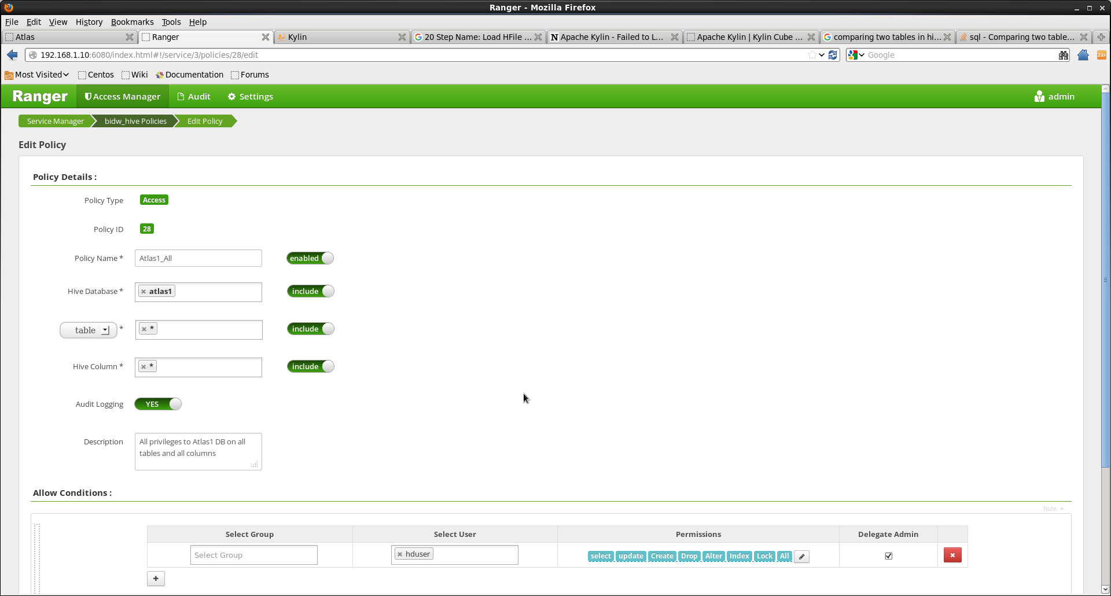
Policy for hduser to read,write atlas1DB
©2015 ITC Infotech. All Rights Reserved.

Slide 32
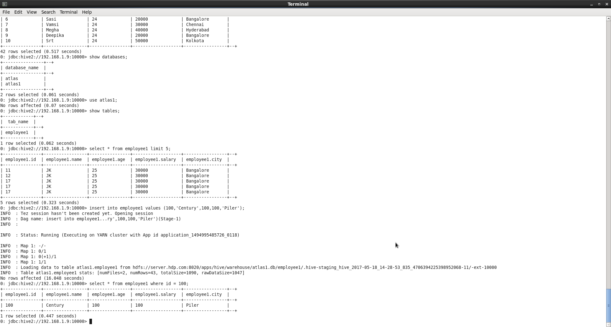
hduser can now write into atlas1DB
©2015 ITC Infotech. All Rights Reserved.

Slide 33
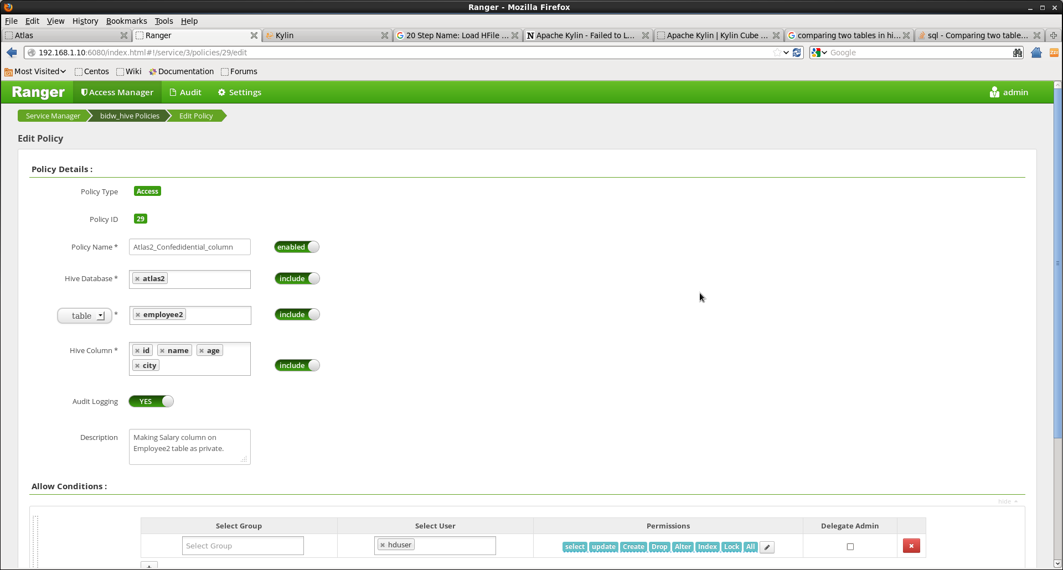
Policy for hduser to access only limited columns in employee table – atlas2DB
©2015 ITC Infotech. All Rights Reserved.

Slide 34
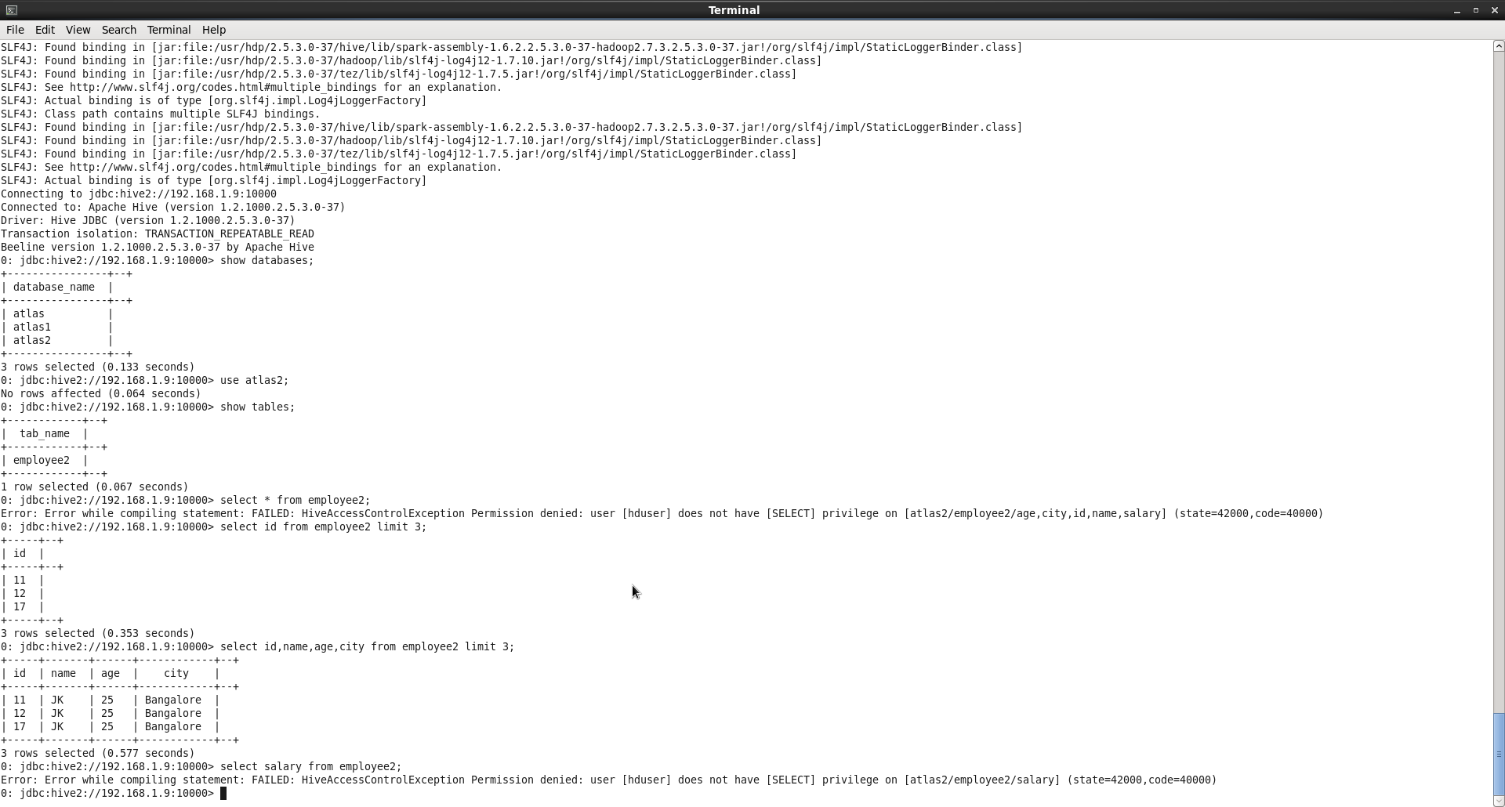
Access on salary column on employee tale is restricted for hduser – atlas2DB
©2015 ITC Infotech. All Rights Reserved.

Slide 35
Create a Tag PII in Atlas
©2015 ITC Infotech. All Rights Reserved.

Slide 36
Created a policy for the tag PII in Ranger
©2015 ITC Infotech. All Rights Reserved.

Slide 37
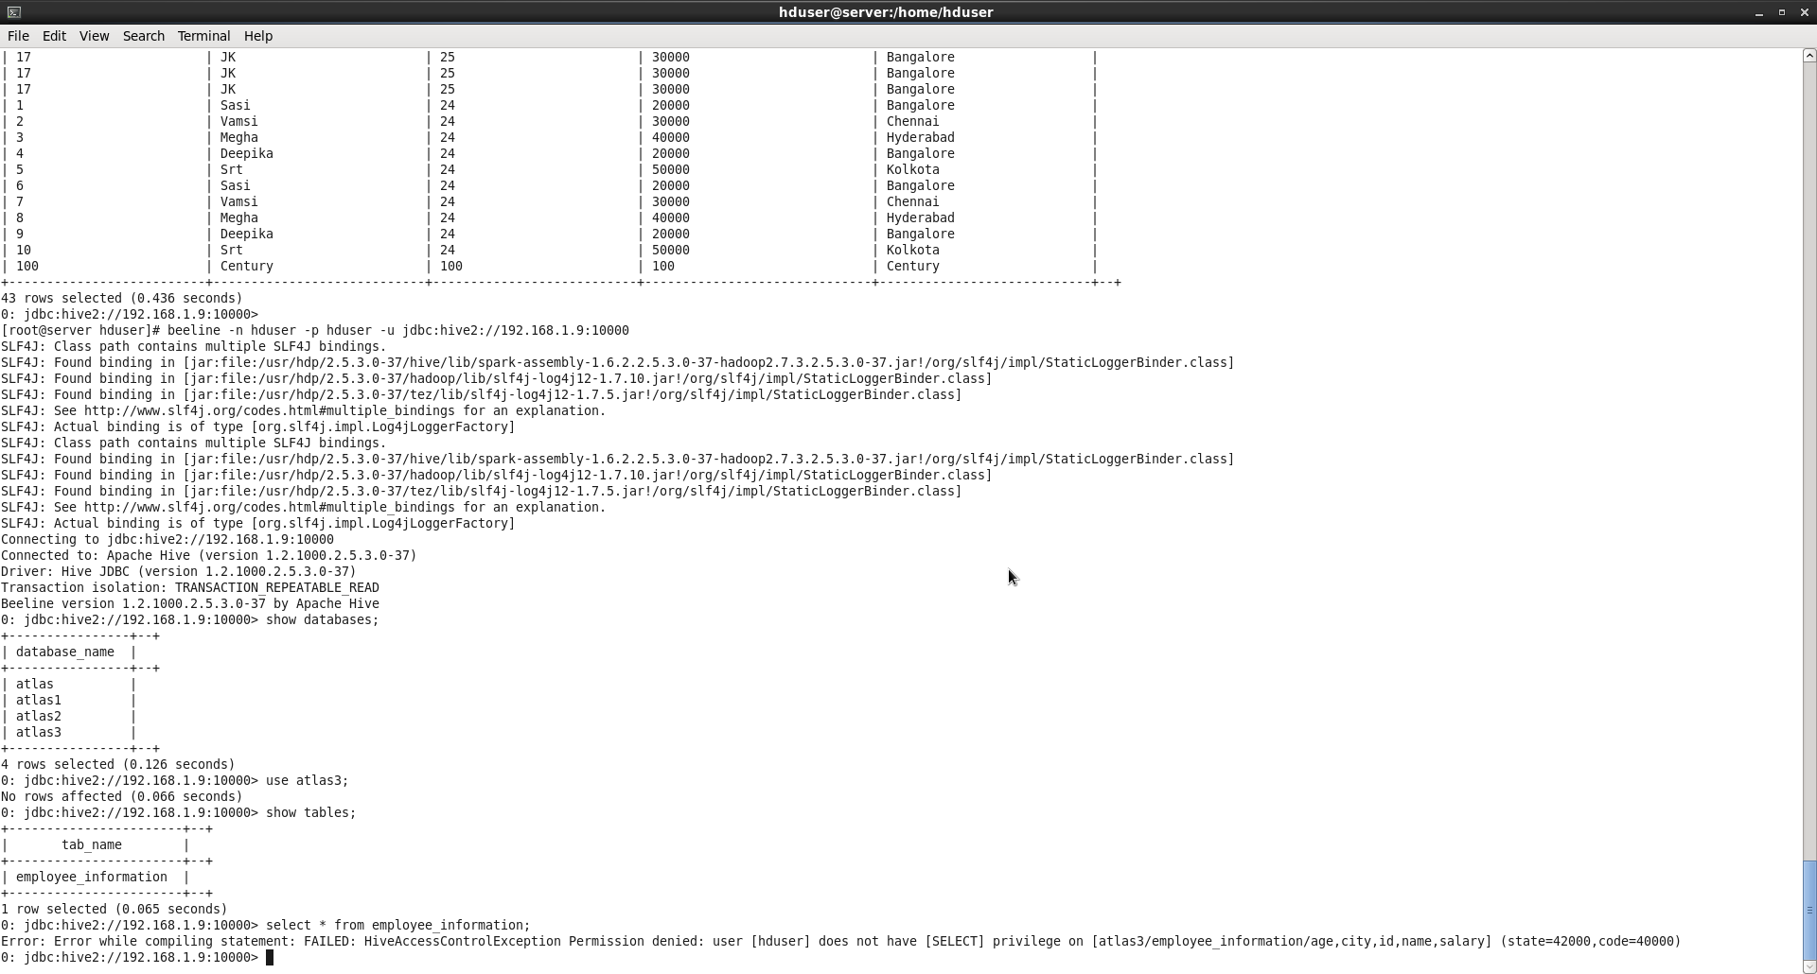
Access is restricted for hduser
©2015 ITC Infotech. All Rights Reserved.

Slide 38
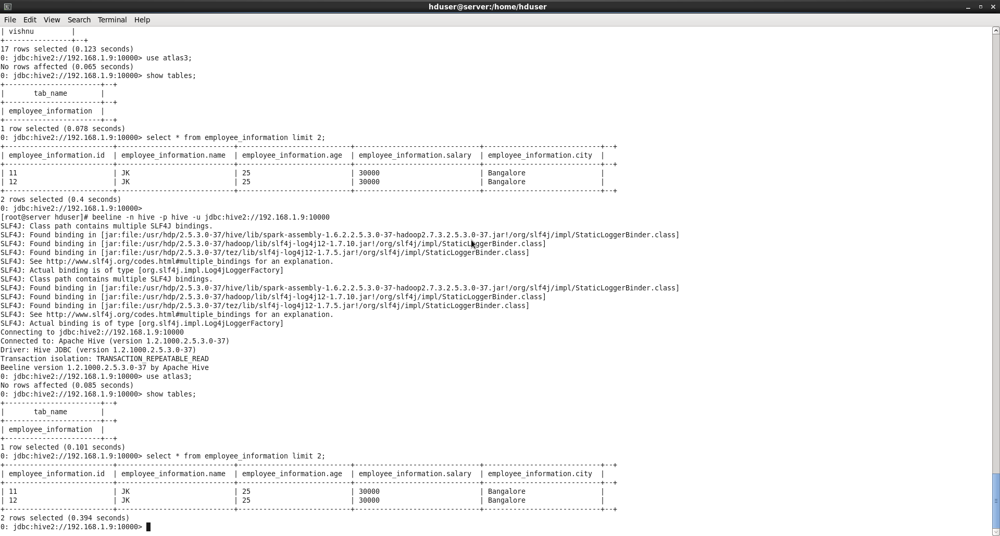
Access is granted for Hive user
©2015 ITC Infotech. All Rights Reserved.

Slide 39
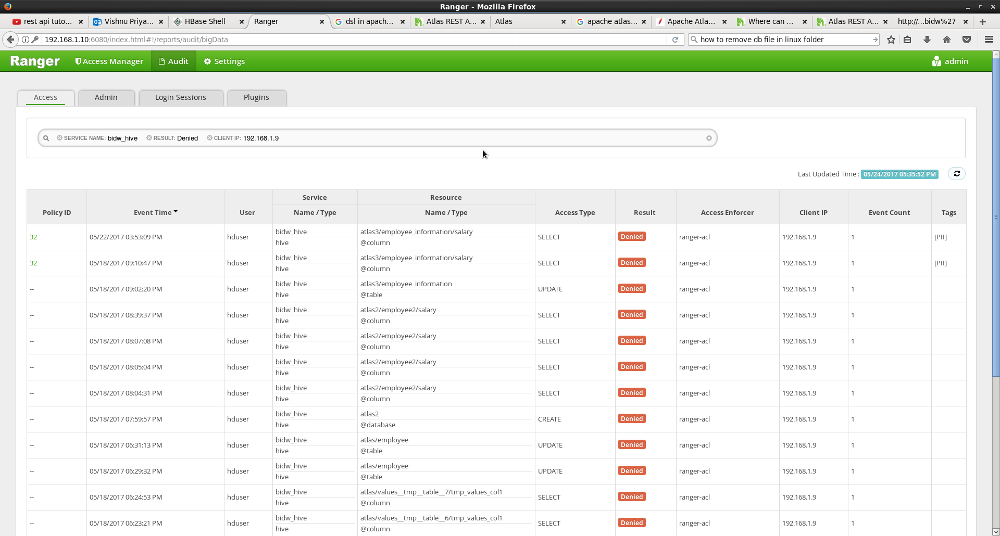
Audit Logging
©2015 ITC Infotech. All Rights Reserved.

Slide 40
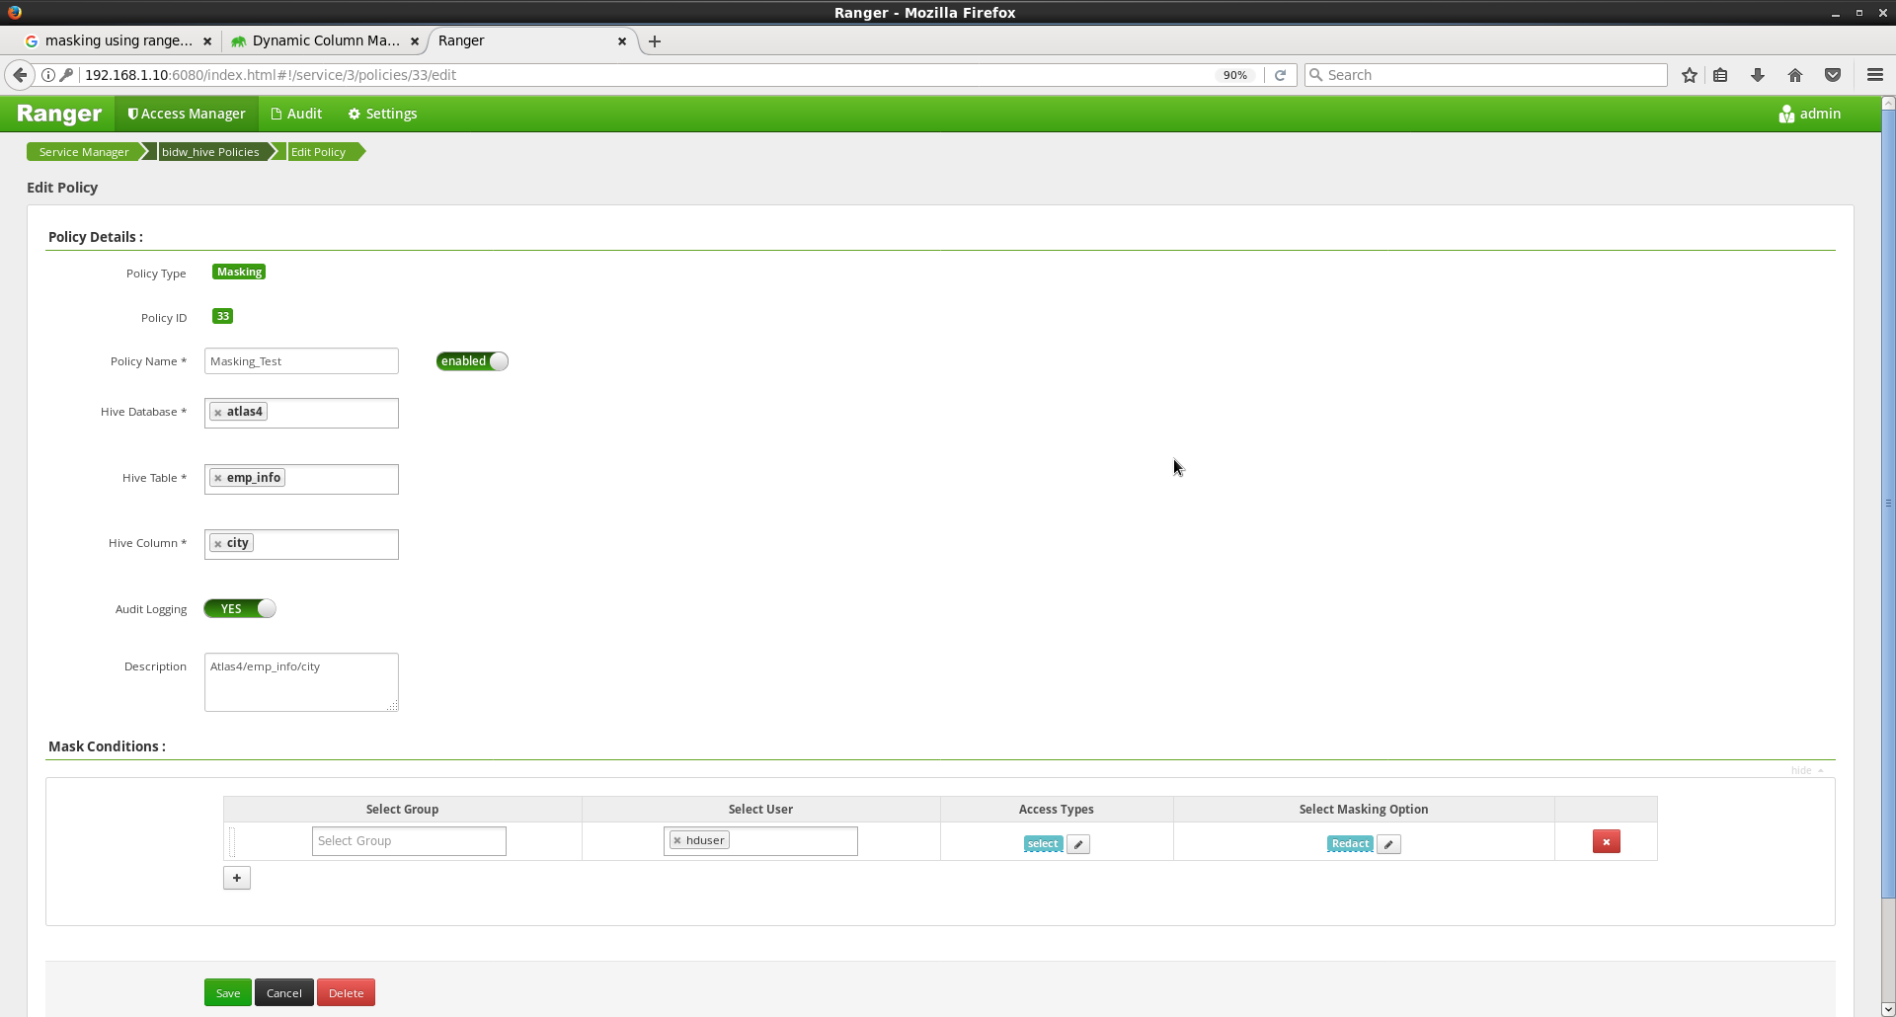
Create a policy for Data Masking
©2015 ITC Infotech. All Rights Reserved.

Slide 41
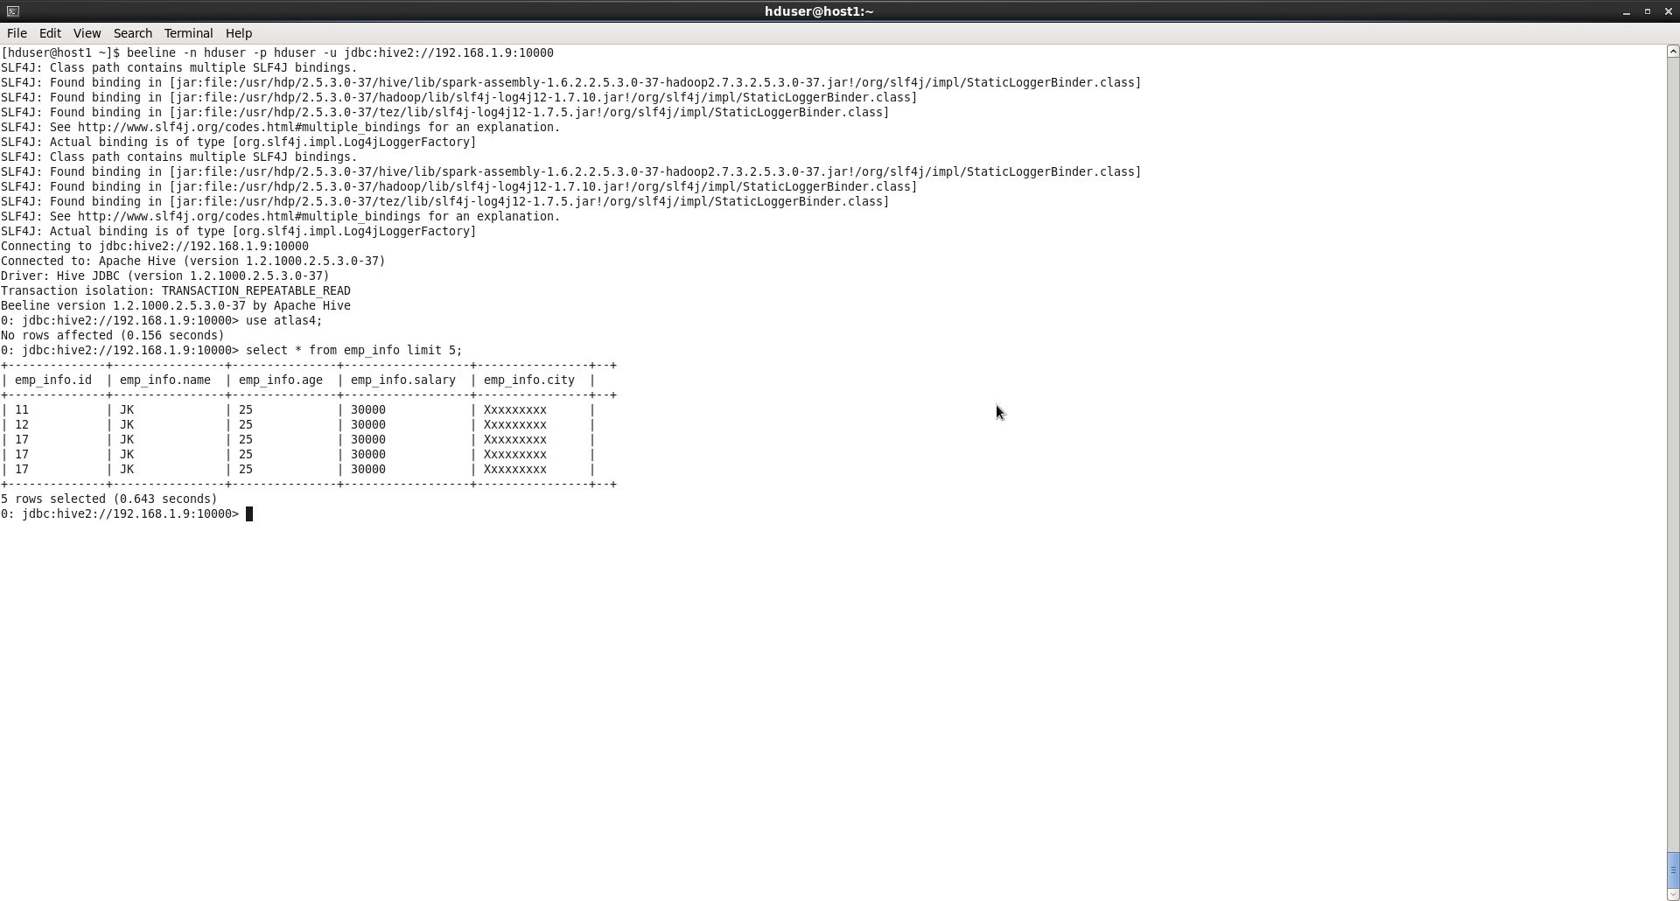
Data is masked
©2015 ITC Infotech. All Rights Reserved.

Slide 42
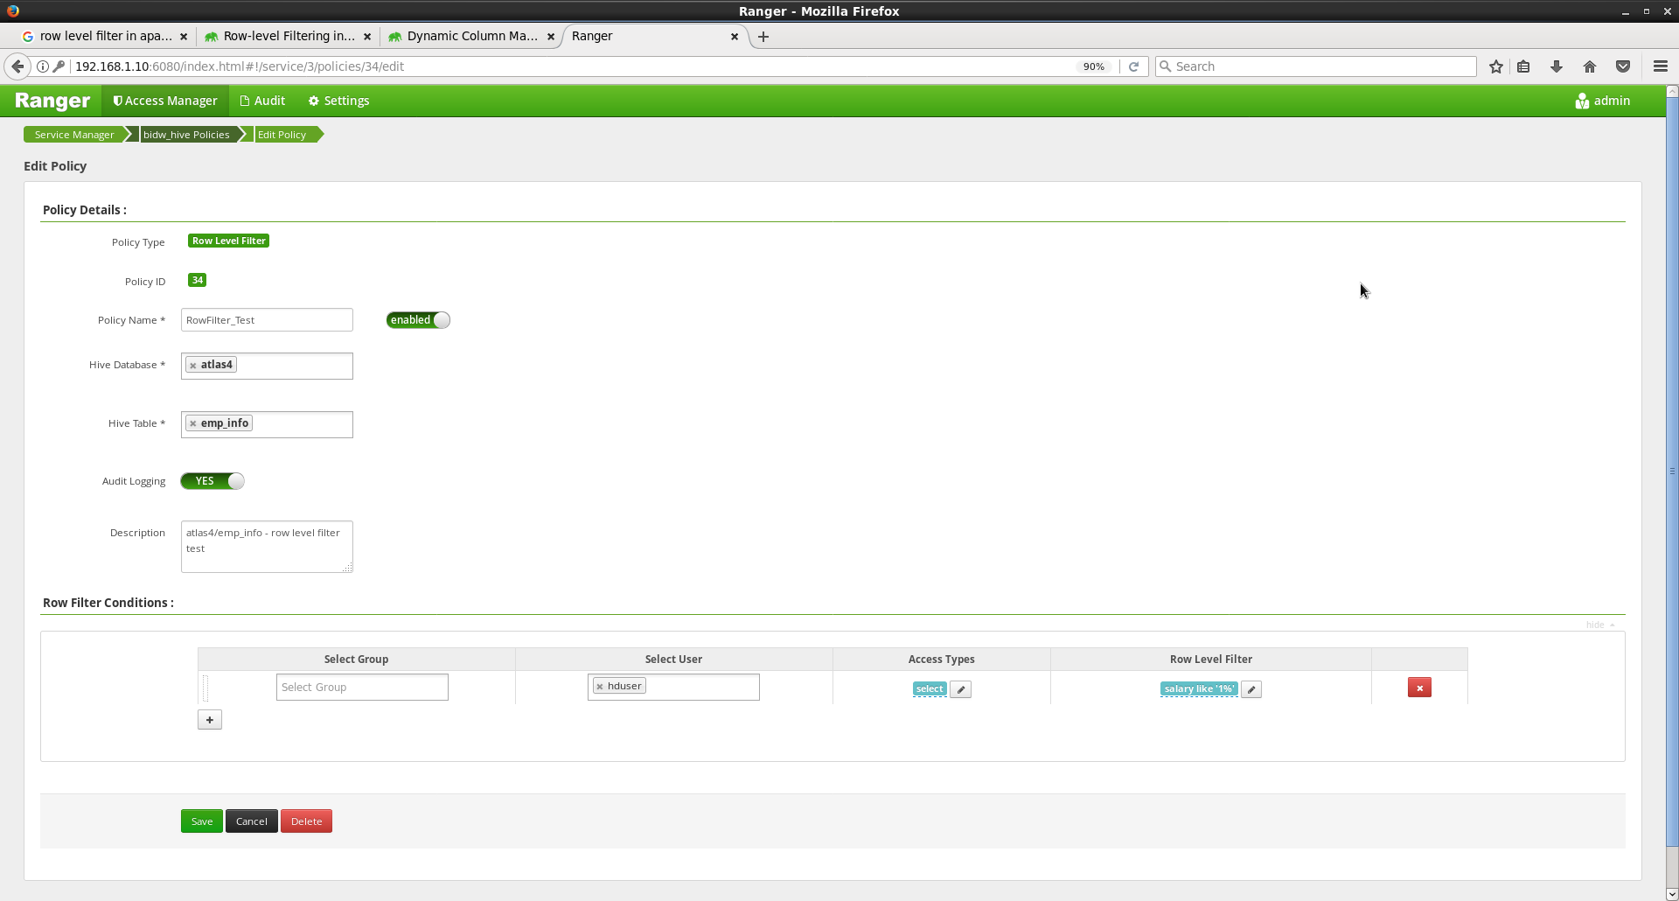
Create a policy for Row Level Filtering
©2015 ITC Infotech. All Rights Reserved.

Slide 43
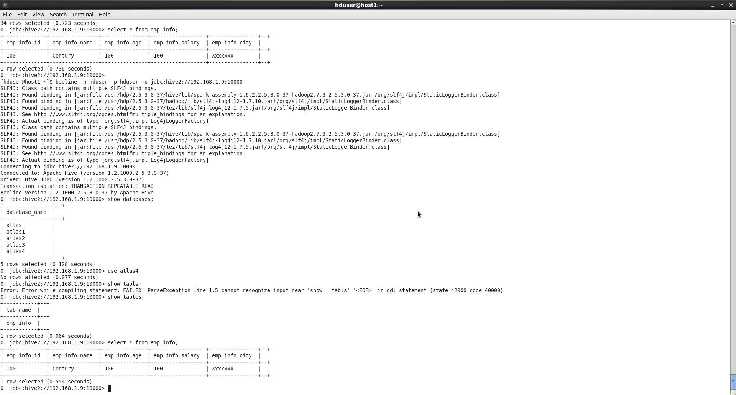
Row Level data is filtered
©2015 ITC Infotech. All Rights Reserved.

Slide 44
Queries ?
©2015 ITC Infotech. All Rights Reserved.

